Slide 1
Transfer Learning

Slide 2
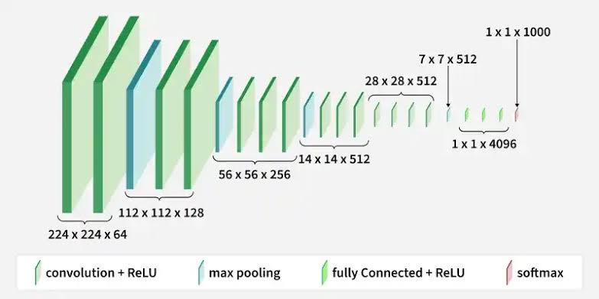
Original VGG

Slide 3
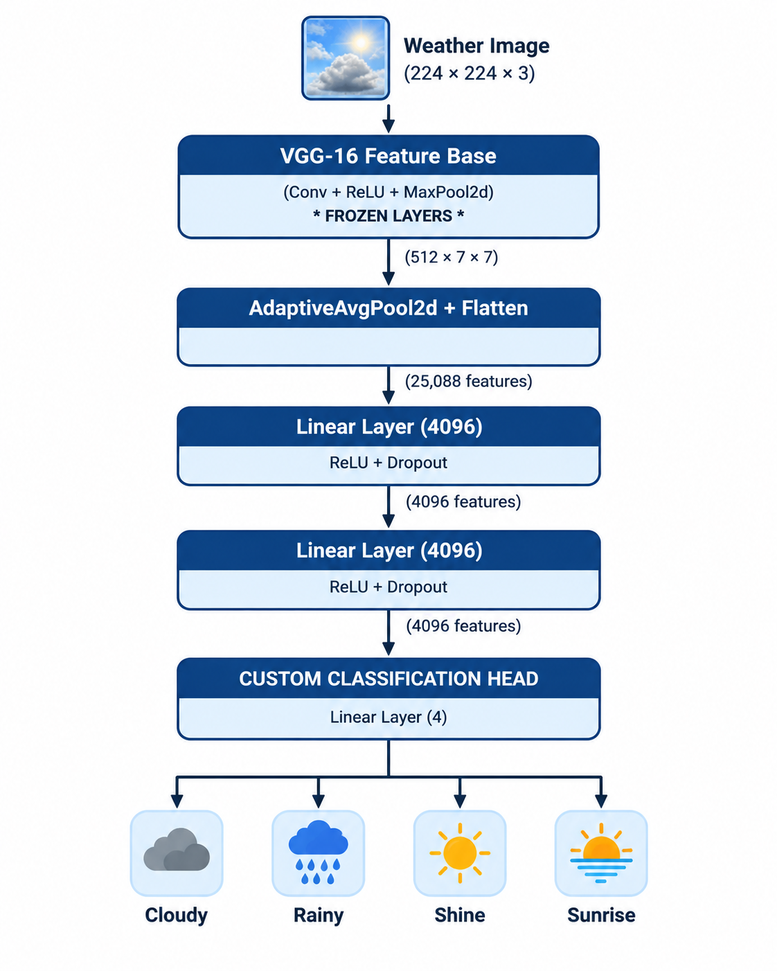
Original VGG Modified

Slide 4
Trainingwith modification:
Epoch 18/25 - Loss: 0.3089, Accuracy: 0.8911
Epoch 19/25 - Loss: 0.2737, Accuracy: 0.8911
Epoch 20/25 - Loss: 0.2939, Accuracy: 0.8944
Epoch 21/25 - Loss: 0.2718, Accuracy: 0.9067
Epoch 22/25 - Loss: 0.2784, Accuracy: 0.8922
Epoch 23/25 - Loss: 0.2428, Accuracy: 0.9211
Model Evalution:
Test Loss: 0.0793
Test Accuracy: 0.9778
By changing the final layer from 1,000 output features to just 4,
the final Linear-39 layer drops from 4,097,000 parameters down to 16,388 parameters (4096 * 4 + 4).

Slide 5
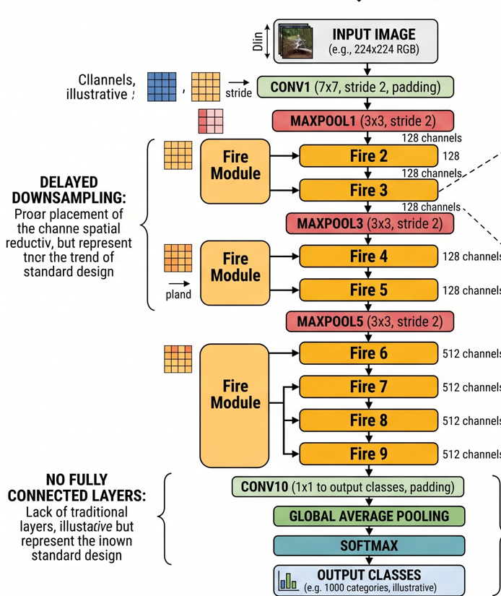
Original Squeezenet

Slide 6
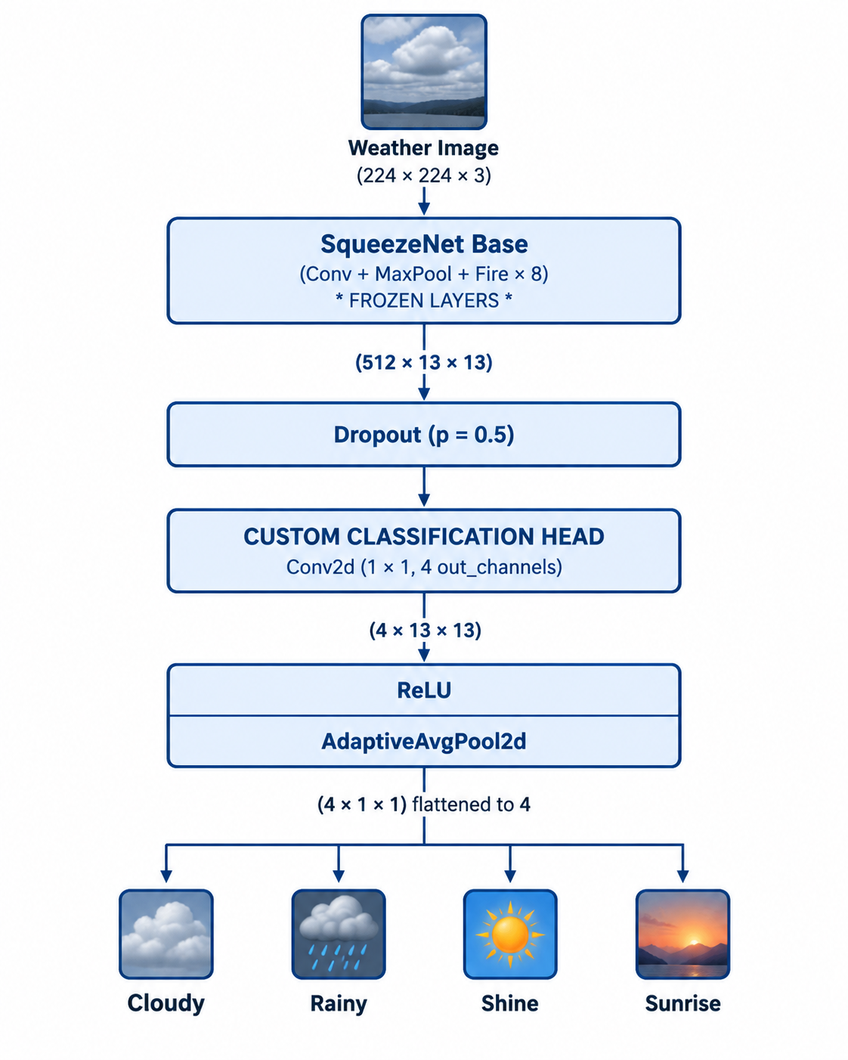
Modified Squeezenet

Slide 7
Starting training... Epoch 1/6 - Loss: 0.1477, Accuracy: 0.9522 Epoch 2/6 - Loss: 0.1331, Accuracy: 0.9544 Epoch 3/6 - Loss: 0.1393, Accuracy: 0.9522 Epoch 4/6 - Loss: 0.1258, Accuracy: 0.9600 Epoch 5/6 - Loss: 0.1305, Accuracy: 0.9578 Epoch 6/6 - Loss: 0.1288, Accuracy: 0.9600 Training complete!
Test Loss: 0.0853 Test Accuracy: 0.9644

